Slide 1
Capstone Project Review #1
(Project Requirements Specification and Literature Survey)
Classical Monte Carlo analysis
(Areas of improvement)
Project Title : Quantum Monte Carlo Algorithm
Project Guide : Dr. Gajanan Honnavar
Project Team : Danush Vikraman PES2UG22EC049
Hannah abagail PES2UG22EC058
Prasanna kesavraj PES2UG22EC099

Slide 2
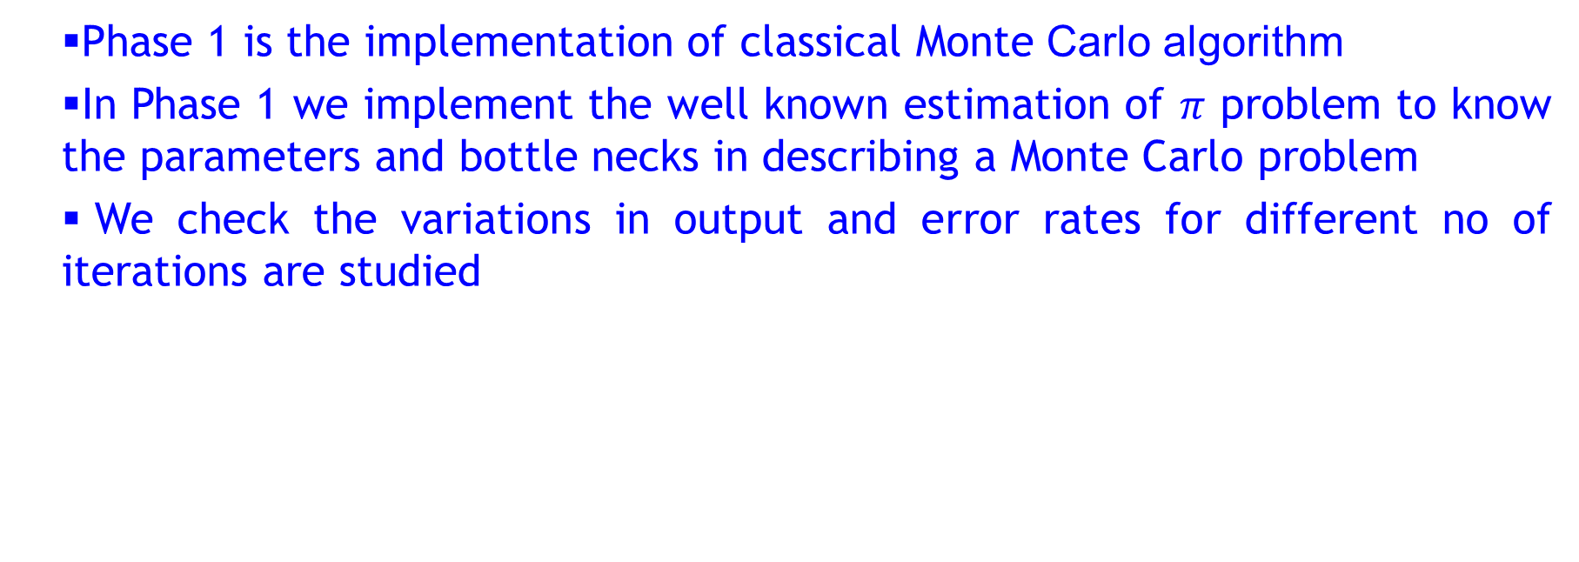
Phase 1- implementation of classical classical Monte Carlo algorithm
Phase 1 is the implementation of classical Monte Carlo algorithm
In Phase 1 we implement the well known estimation of $π$ problem to know the parameters and bottle necks in describing a Monte Carlo problem
We check the variations in output and error rates for different no of iterations are studied

Slide 3
Steps in classical classical Monte Carlo algorithm
Deterministic model description of the problem :We build a deterministic model description of the problem statement (That uses the best case input parameters).This is unique each problem statement.
We add the risk components to the model. As mentioned before, since the risks originate from the stochastic nature of the input variables, we try to identify the underlying distributions, if any, which govern the input variables.
Random Variable Generation: After we have identified the underlying distributions for the input variables, we create a set of random numbers from these distributions. These random inputs will be used in the deterministic model, to deliver one set of output values.

Slide 4
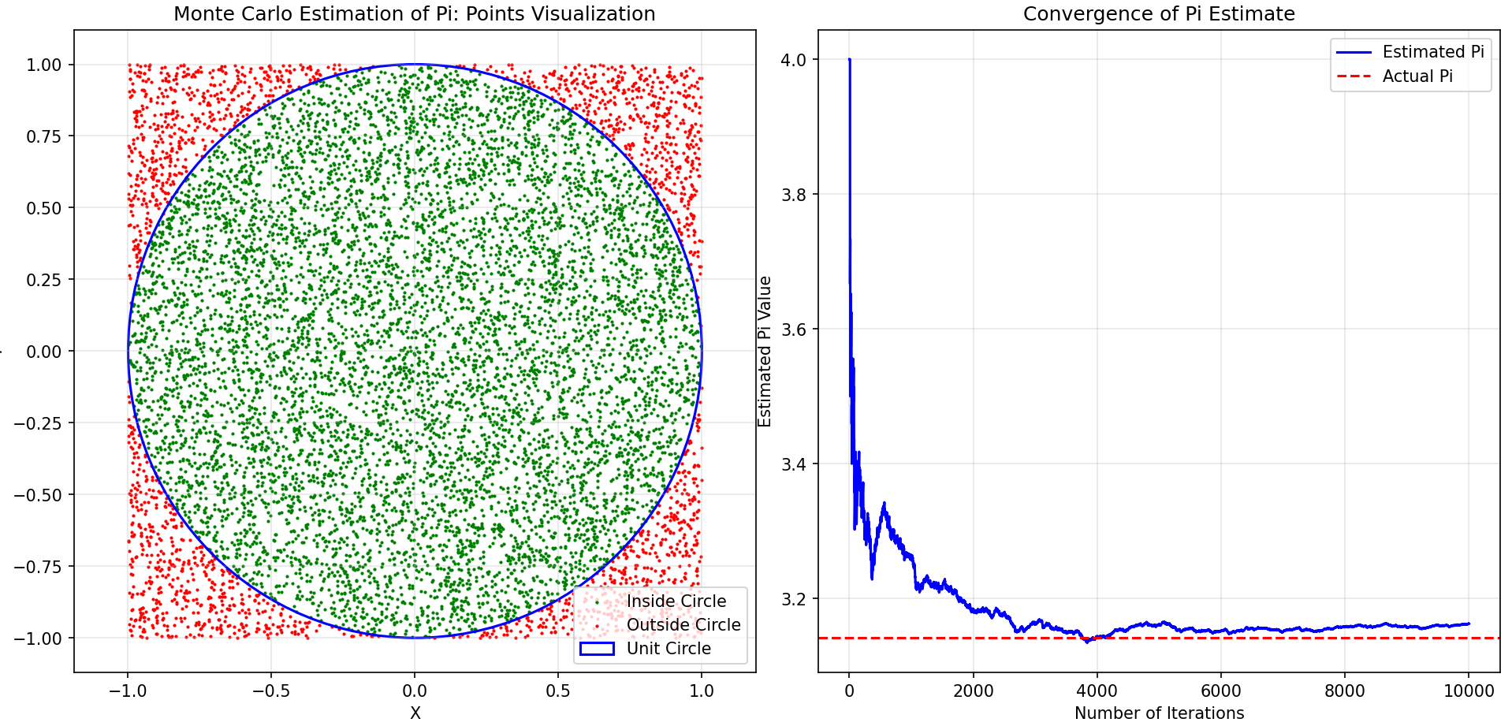
Estimated value of Pi: 3.16240

Slide 5
Limitations of MC Algorithm
High time complexity
Trade-off between algorithm efficiency and accuracy
As no of iterations increase the algorithm execution time increases
Low accuracy and higher error rates at lower no of iterations

Slide 6
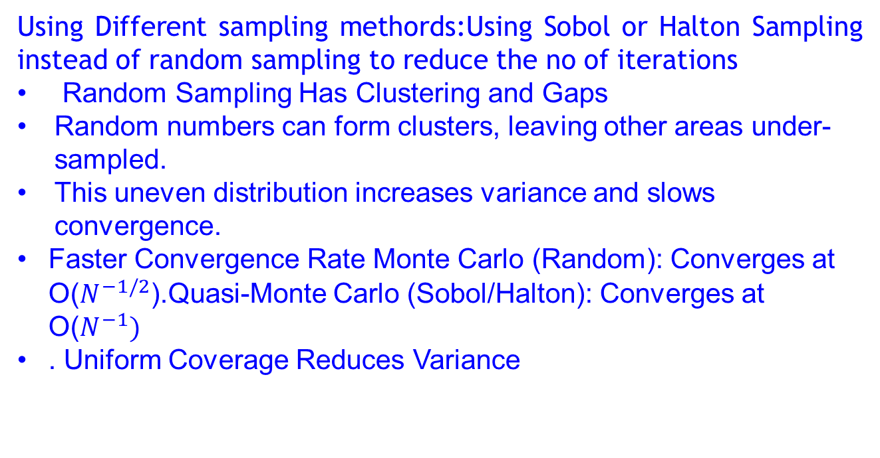
Possible solutions to limitations in classical MC
Using Different sampling methords:Using Sobol or Halton Sampling instead of random sampling to reduce the no of iterations
Random Sampling Has Clustering and Gaps
Random numbers can form clusters, leaving other areas under-sampled.
This uneven distribution increases variance and slows convergence.
Faster Convergence Rate Monte Carlo (Random): Converges at O($N^{−1/2}$).Quasi-Monte Carlo (Sobol/Halton): Converges at O($N^{−1})$
. Uniform Coverage Reduces Variance

Slide 7
Comparison between random sobol and halton sampling
Feature | Sobol | Halton | Random
Best for | High-dimensional (d>10) | Low-dimensional (d≤5) | General use
Distribution | Highly uniform | Uniform but correlated in high dimensions | Clustering & gaps
Performance | Best for large-scale problems | Good for 2D/3D problems | Slower convergence

Slide 8
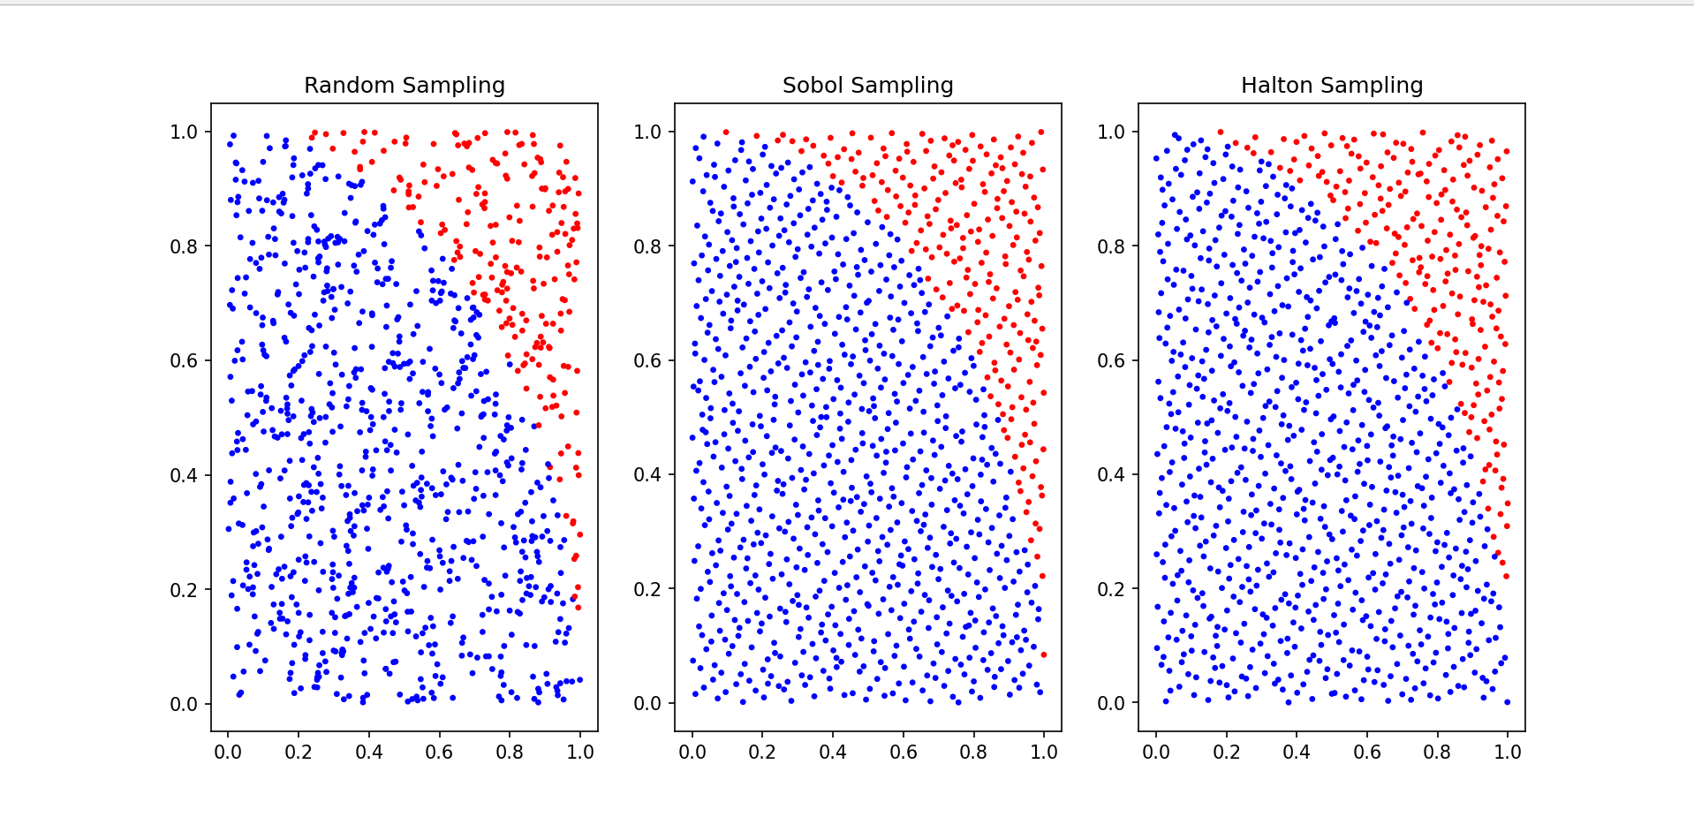
Exact π: 3.141593
Random Sampling Estimate: 3.160000
Sobol Sampling Estimate: 3.148000
Halton Sampling Estimate: 3.144000

Slide 9
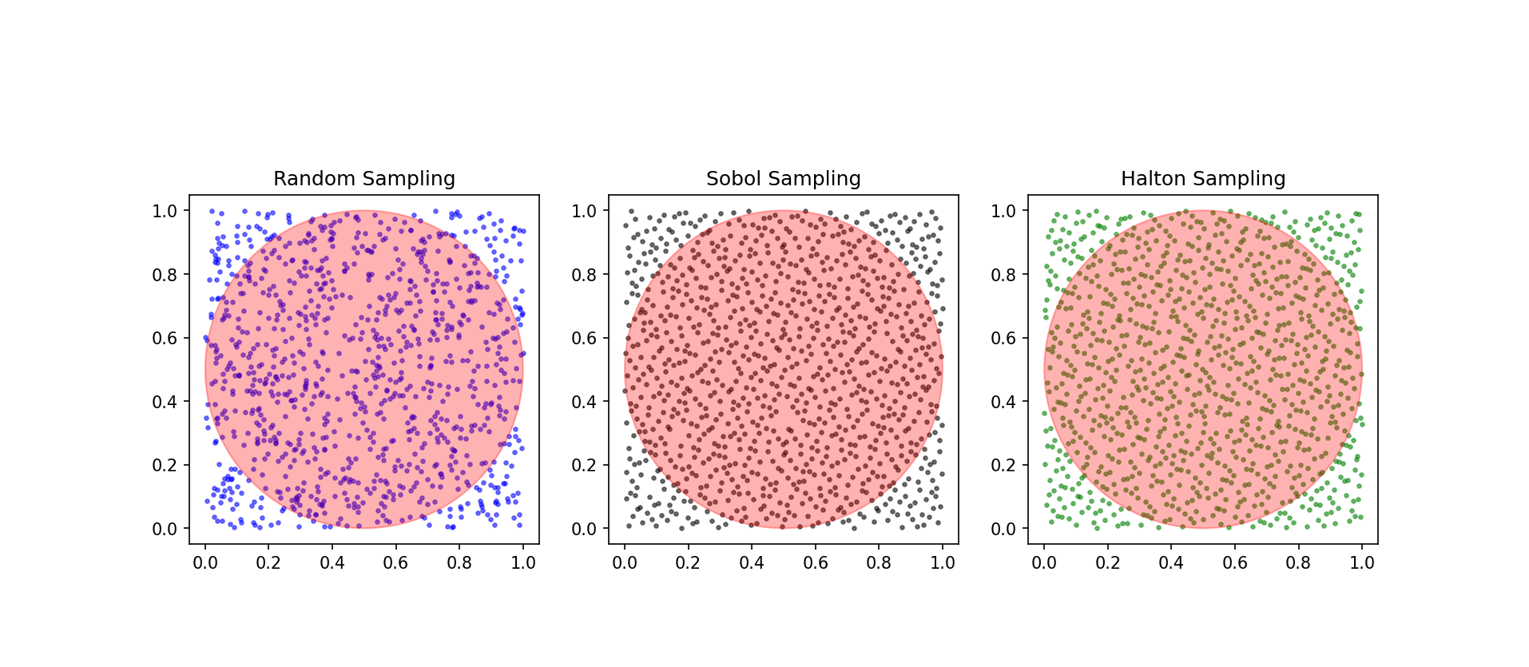
Random Sampling Pi Estimate: 3.180000
Sobol Sampling Pi Estimate: 3.160000
Halton Sampling Pi Estimate: 3.140000

Slide 10
Paper Details | Objective of paper, Techniques/Methods | Advantages | Limitations
Proceedings of the 2008 Winter Simulation Conference S. J. Mason, R. R. Hill, L. Mönch, O. Rose, T. Jefferson, J. W. Fowler eds. INTRODUCTION TO MONTE CARLO SIMULATION Samik Raychaudhuri Oracle Crystal Ball Global Business Unit 390 Interlocken Crescent, Suite 130 Broomfield, C.O. 80021, U.S.A | introductory tutorial on Monte Carlo simulation, a type of simulation that relies on repeated random sampling and statistical analysis to compute the results. | Comprehensive description of classical Monte Carlo algorithm | No real innovations made to improve MC Algorithm
Literature Survey

Slide 11
Paper Details | Objective of paper, Techniques/Methods
Q. Liu, B. Feng, Z. Liu, Z. Hao and H. Zhang, "The improvement of sobol' sensitivity analysis method," 2015 First International Conference on Reliability Systems Engineering (ICRSE), Beijing, China, 2015, pp. 1-5, doi: 10.1109/ICRSE.2015.7366460. | Sobol' sensitivity analysis method is widely used as a classical approach in global sensitivity analysis. this paper improves the integral used for calculating conditional variance, and proves that it can reduce error in the view of Monte Carlo method; besides, Sobol' low discrepancy sequence is replaced by another quasi-random numbers with lower star discrepancy generated by uniform design to increase accuracy of Quasi-Monte Carlo method. A numerical example verifies that both measures can effectively improve accuracy of estimation of sensitivity index for Quasi-Monte Carlo method..
Literature Survey

Slide 12
Summary of Literature Survey
In conclusion to phase 1 the key points are :
Every problem model in Monte Carlo is unique
The changes that we can make are to the input distribution parameters and to the sampling methods to achieve better performance
Error correction at an earlier phase , QMC comparison ,QMC on pure quantum computer and data point prioritization are areas to be explored

Slide 13
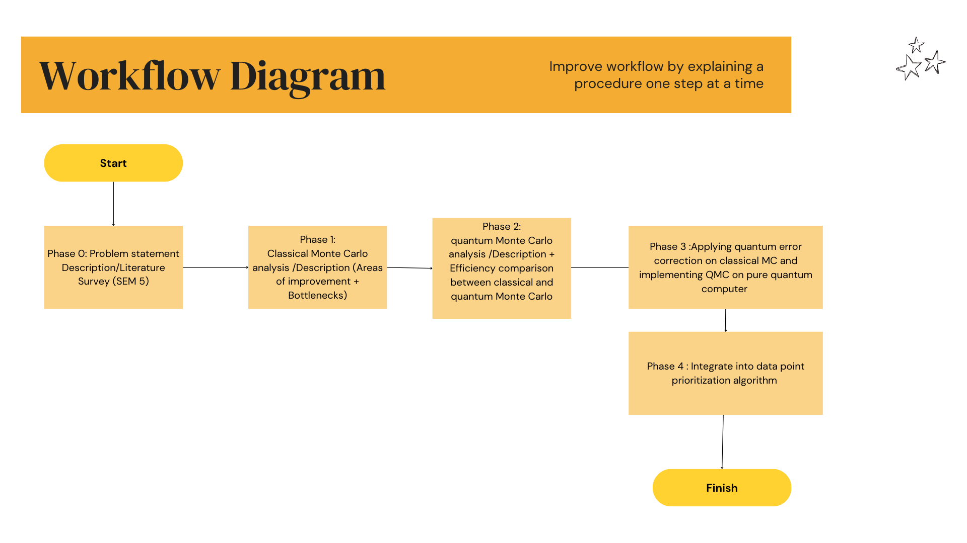

Slide 14
Thank You

